Slide 1
Unit 1- Basics of Fluid Power and Pumps (part1)
Dr. S.S. Deshpande, Associate Professor (Mechanical Engineering)
GCOER Avasari

Slide 2
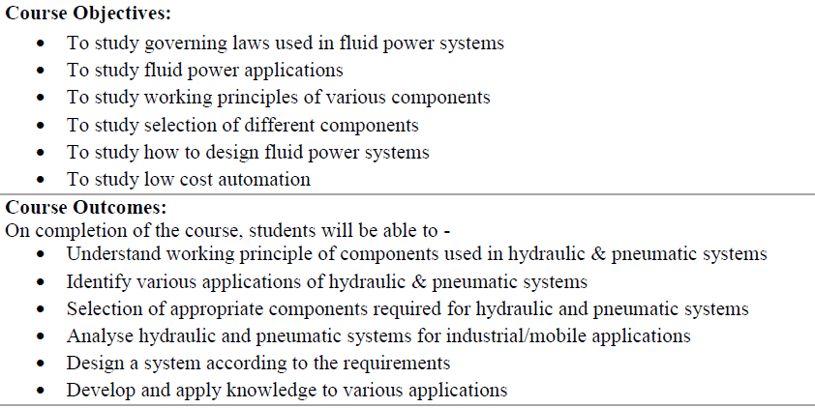

Slide 3
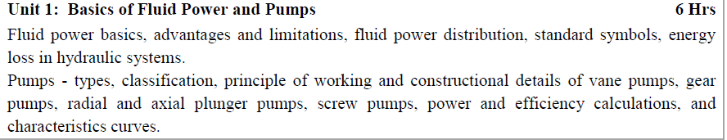

Slide 4
Basics
Advantages and limitation
Fluid power distribution
Standard symbols
Energy loss in Hydraulic systems

Slide 5
Pump-
Types
Classification
Vane pump
Gear pump
Radial pump
Axial plunger pump
Screw pump
Power and efficiency calculations
Characteristic curves

Slide 6
Losses
Friction
Leakages
Losses due to friction increase with rise in viscosity
Losses due to leakage decrease with rise in viscosity

Slide 7
Head loss
λ= coefficient of frictional loss
h_{p}= head loss …….meters of fluid
V= velocity …m/s
l= length of pipe …..m
d= diameter of pipe ….m
g= acceleration due to gravity

Slide 8
λ depends of
Type of fluid flow
Inner surface finish
Viscosity
Laminar flow, Polished pipes λ =64/R_{e} (R_{e} 2000 to 2300)
Laminar flow, other pipes λ =6.75/R_{e} (R_{e} < 1200)
turbulent flow, other pipes λ =0.316/R_{e} (R_{e} >2500)
For laminar and turbulent 1200<R_{e} <2000

Slide 9
Losses in Pipe fittings
K= factor of fitting

Slide 10
Pressure drop (Kg/m²)
ρ= density (kg/m³)
If the formula is multiplied by g … Kg/m² unit becomes N/m²
if cm is used …..

Slide 11
Pumps
Heart
Converts mechanical power of the prime mover to hydraulic power by pressuring the oil
Fluid is supplied to various parts
Flow rate, pressure
As the fluid encounters load/resistance, pressure is developed

Slide 12
Cavitation
Occurs in suction line of pump
Vapor pressure
Bubble formation
When bubble collapse, vacuum is created
Liquid from surrounding region rushes to this spot
create a momentary high pressure
Damages metal part

Slide 13
Inlet (suction)
Outlet (delivery)
Continuous supply of fluid at inlet by sump

Slide 14
classification
Positive displacement of pump (hydrostatic)
Rotodynamic pumps (hydro dynamic)
Hydrostatic
Fix volume is taken in the pumping chamber
No change in kinetic energy of fluid
Pure pressure energy is in output side
No slippage of fluid
Always deliver constant volume of pump irrespective of pressure /resistance

Slide 15
More restriction at delivery valve , more pressure
The flow rate is dependent of speed alone
Discharge is in discrete volumes and not continuous
Based on configuration
Reciprocating type
Rotary type
Based on delivery
Fixed delivery pumps
Variable delivery pumps

Slide 16
Reciprocating type
Classification
Axial plunger type
Radial Plunger type
Series plunger type

Slide 17
Rotary type
Vane pump
Gear Pump
Screw Pump

Slide 18
Positive Disp pumps based on delivery
Fixed delivery
(at fixed rpm, rate of flow is fixed)
fixed geometrical displacement
But flow control valve can be used
Simple in construction
Volume delivered per revolution can not be changed
Variable delivery
Varying geometrical displacement
Volume delivered per revolution can be changed
Complex in design, construction, operation

Slide 19
Rotodynamic Pumps
External work is imparted to the fluid in the control volume in the form of kinetic energy
Fast rotating impeller
Kinetic energy increases
Fluid starts moving at high velocity
Velocity head is converted into pressure head
Fluid moves continuously
Discharge is continuous not discrete
Continuous process of suction, rotary motion, discharge
Pressure variation is continuous from the suction to the discharge line

Slide 20
Positive displacement | Rotodynamic pump
Delivers in discrete volumes | Continuous
One delivery per stroke | Suction and delivery is continuous
Low pressure and high pressure regions | No such regions. Variation is continuous
Work done is in the form of pressure energy | Work done is in the form of kinetic energy
No limit to maximum pressure | Limit to max pressure

Slide 21
Vane pumps
(siding vane pumps)
Components
Rotor with radial slots
Sliding vanes
Circular ring or casing (stator)
Port plates with kidney shaped inlet and delivery ports

Slide 22
Classification of vane pumps
Fixed displacement
Unbalanced
Balanced (elliptical and not circular)
Rotor is mounted co axial with the stator
Diametrically opposite regions

Slide 23
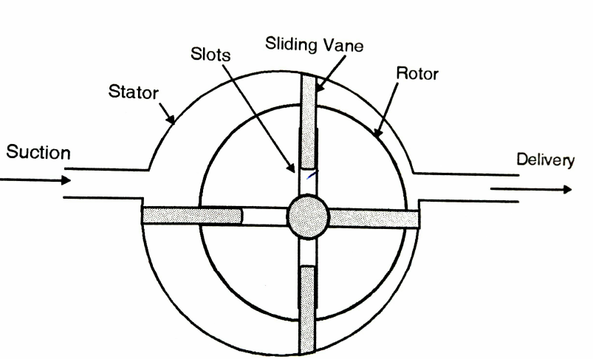
Components of Vane Pumps

Slide 24
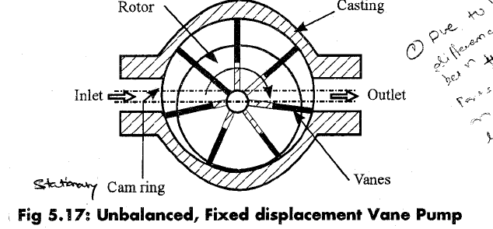

Slide 25
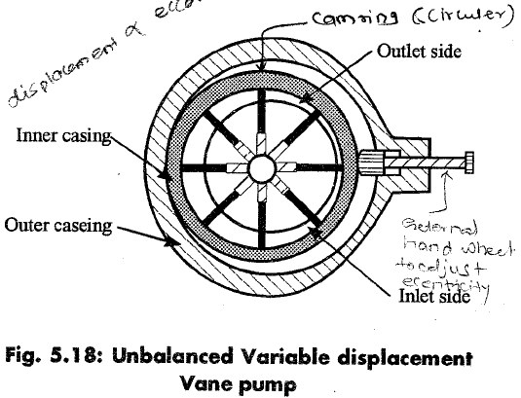

Slide 26
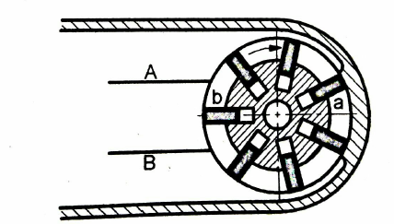
Variable displacement. Zero discharge (zero eccentricity)

Slide 27
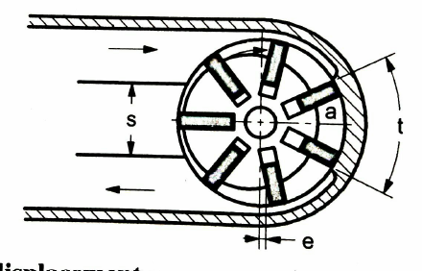
Variable displacement. Max discharge position (max eccentricity)

Slide 28
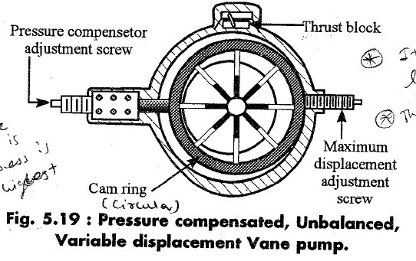
Variable displacement Eccentricity between rotor and casing can be adjusted

Slide 29
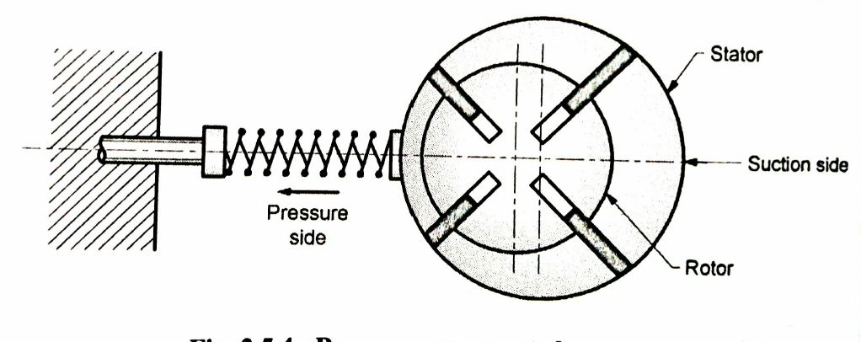
Pressure Compensated

Slide 30
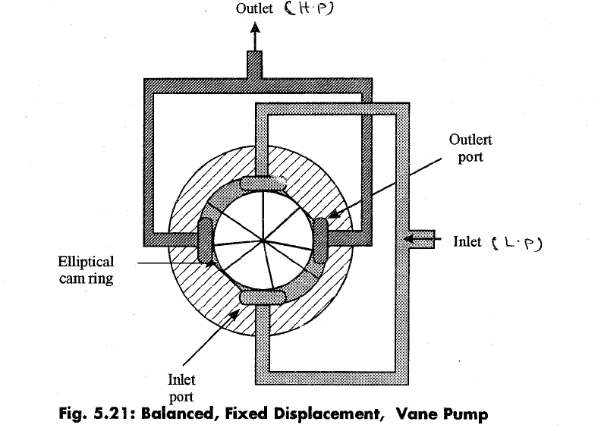

Slide 31
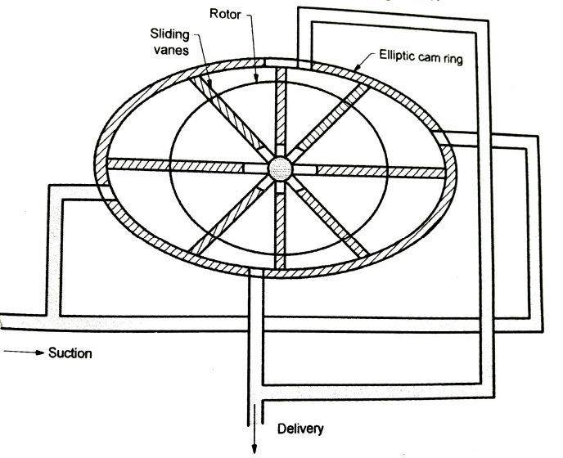
Simplified diagram

Slide 32
Pressure compensated
Discharge remains constant irrespective of pressure

Slide 33
Geometric displacement of a vane pump
Q=4πR b e n
R= radius of casing
b= breadth of vane
e= eccentricity
n= rpm

Slide 34
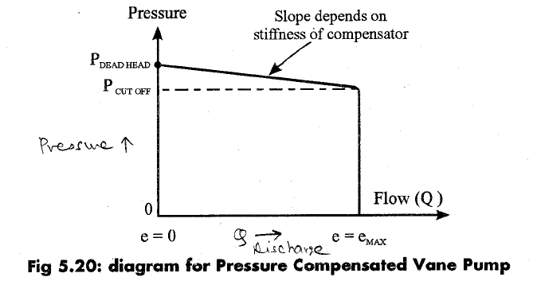

Slide 35
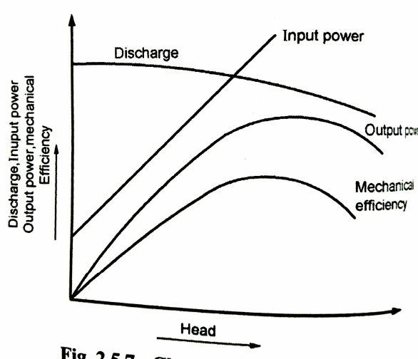
Characteristics of vane pumps

Slide 36
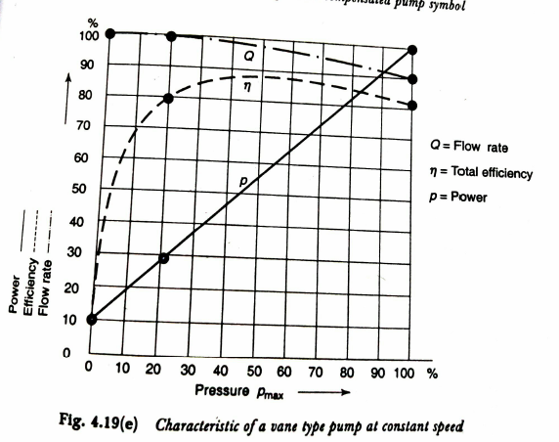

Slide 37
Salient features of Vane pumps
Medium to high pressure applications
Production is easy
Variable discharge can be easily obtained
Flow is more ripple free
Low noise

Slide 38
Drawbacks of vane pumps
Unbalanced rotor as high and low pressure to the two sides
Suction side below atmospheric
Delivery side, very high pressure
Vane loading, wear and tear, friction , losses
Vane loading centrifugal action/ spring force
Connecting to system pressure (rotor and vanes)

Slide 39
Gear Pump
Positive displacement pump
High pressure
Low discharge
Simple in design
Cheap
Handle variety fluids (not water)
Classification of gear pumps

Slide 40
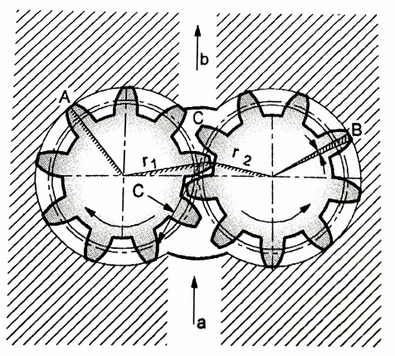
Basic principle of working of Gear Pump
Note the direction of rotation and direction of flow

Slide 41
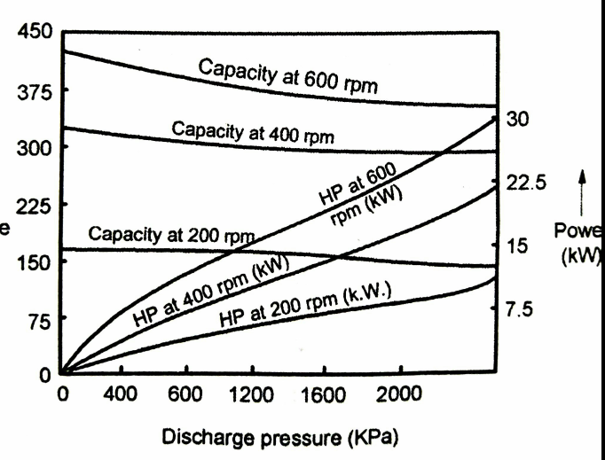
Performance characteristics of external gear pump
On Y axis Discharge in LPM

Slide 42
Drawback of gear pump
Excessive side loading on the shaft due to difference in pressure
Side thrust on gear shaft due to helix angle in helical gears
Herring bone gears are suggested

Slide 43
Helical gear pumps
Superior to spur gear pumps
Overlapping of teeth- continuous , smooth, uniform discharge
Less noisy
Side thrust is main drawback

Slide 44
Herring bone gear pump
Double helix
Side thrust is eliminated

Slide 45
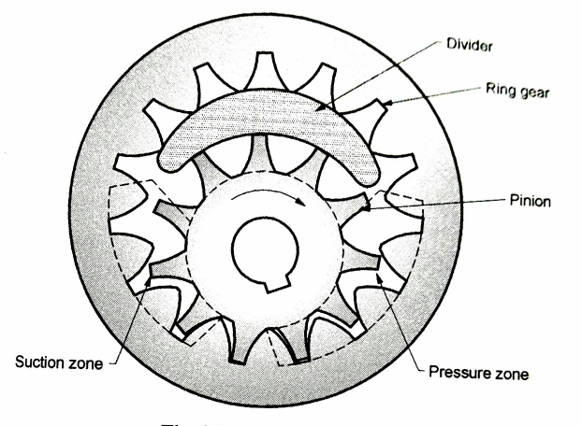
Internal gear pumps

Slide 46
The divider is stationary
Pinion rotates so the internal gear also rotates in same direction
Suction and discharge ports are at back side

Slide 47
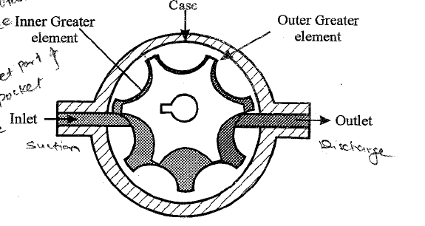
Gerotor Pump (Internal meshing)

Slide 48
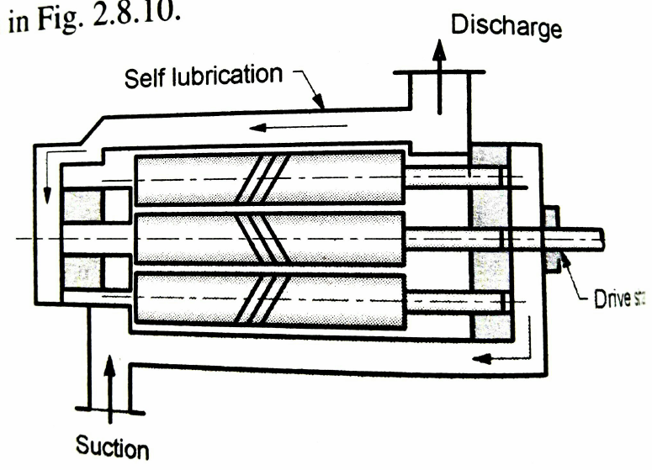
Screw Pumps

Slide 49
Screws mesh (like gears mesh)
Driving screw , driven screw
Axial flow
Advantages
Wide range of flow and pressure
Wide range of liquids
Low internal velocities
Low vibration and noise
Pulsation free
Rugged and compact]
High speed operation

Slide 50
Disadvantages of screw pumps
High Cost

Slide 51
Plunger (piston pumps)
Pumping action is caused by a special cam arrangement.
More cylinders, more uniform flow
Cylinders can be arranged in
Axial plunger
Bent axis type
Swash plate type
Rotating cylinder type
Rotating swash plate type
Radial plunger
Inline plunger

Slide 52
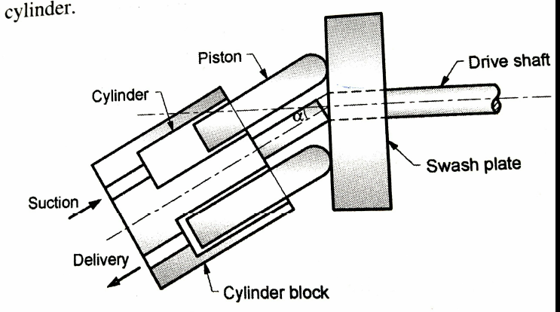
Bent Axis

Slide 53
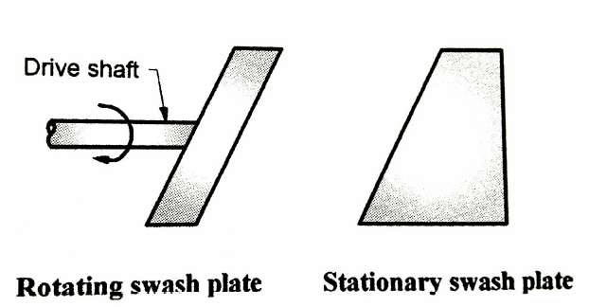
Swash plate type

Slide 54
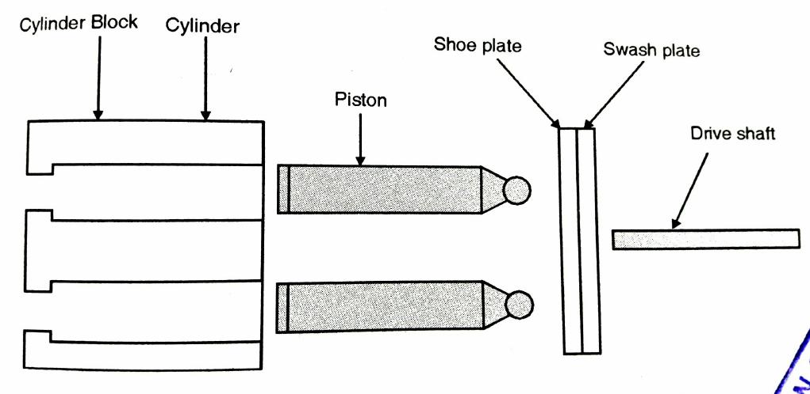
Rotating cylinder type

Slide 55
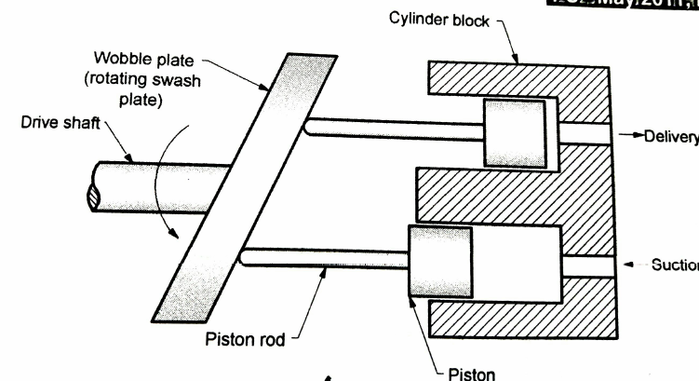
Rotating swash plate type

Slide 56
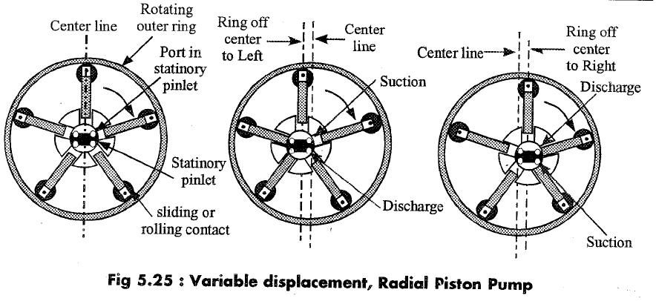

Slide 57
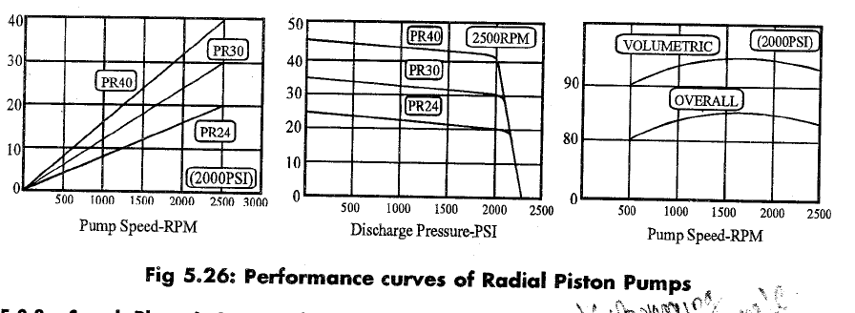
Pump performance

Slide 58
Power
Power= pressure x discharge
A separate presentation will be shared on numerical/ problems on pumps based on SPPU syllabus

Slide 59
Factors affecting the selection of type of pump
allowable pump speeds
Max and safe system pressure in working conditions
Performance characteristics
Efficiency
Durability
Operating reliability
Operation at variable loads/speeds

Slide 60
Cost
Variable discharge capability
Wear
Temperature of operation
Noise
Manufacturing characteristics
Power to weight ratio
compactness

Slide 61
Thanks

